Slide 1

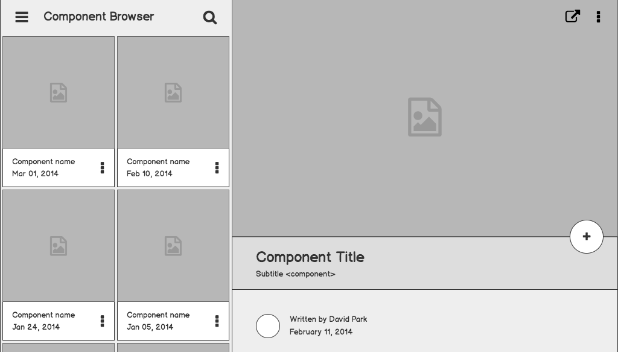

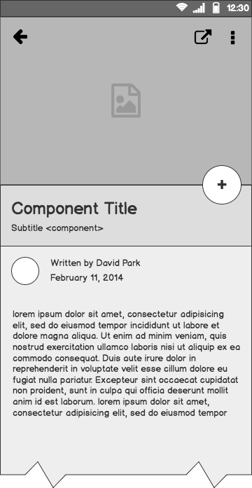
AWS SECURITY LAB TECHNICAL DEMO
TEAM FOUR:
KHOREY BROWN, MARIANA ESPINOZA, PEDRO GOMEZ, SHANTERICKA GREENE, JAYDIN MOHAN, REBECCA SILOS, FERNANDA SOMOHANO, JUSTIN VARGAS

Slide 2
TECHNICAL PRESENTATION OUTLINE
OBJECTIVE
VPC CREATION AND CONFIGURATION
EC2 INSTANCES
SECURITY TOOLS/SOLUTIONS

Slide 3
OBJECTIVE : CREATE A SECURITY TRAINING LAB IN AWS WITH A KALI ATTACKBOX, A VULNERABLE TARGET, FIREWALL, SIEM TOOL WITH ENDPOINT AGENTS, AND IDS/IPS FUNCTIONALITY.

Slide 4
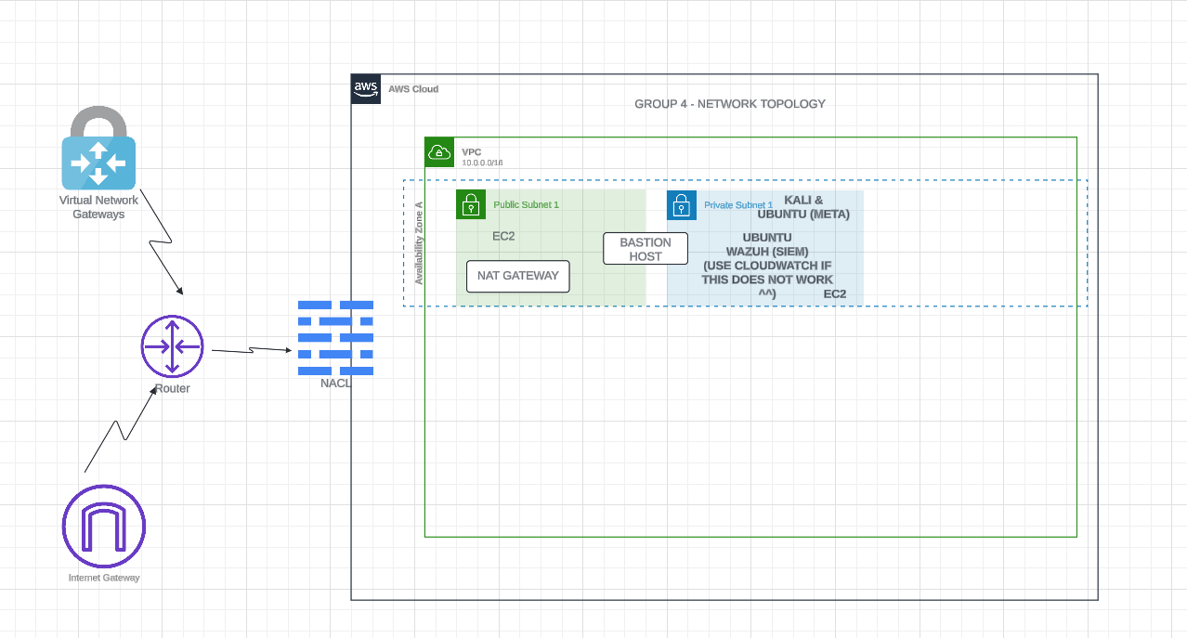
CLOUD LAB ARCHITECTURE
Shantericka Greene/Rebecca Silos

Slide 5
AWS VPC
AWS VPC allows us to launch a virtual private cloud to host our security lab resources.
This allows us to have a secure, isolated environment for our ethical hacking simulations with Kali and our vulnerable resource in a private cloud hosted within the AWS public cloud.
Notes:
Mariana

Slide 6
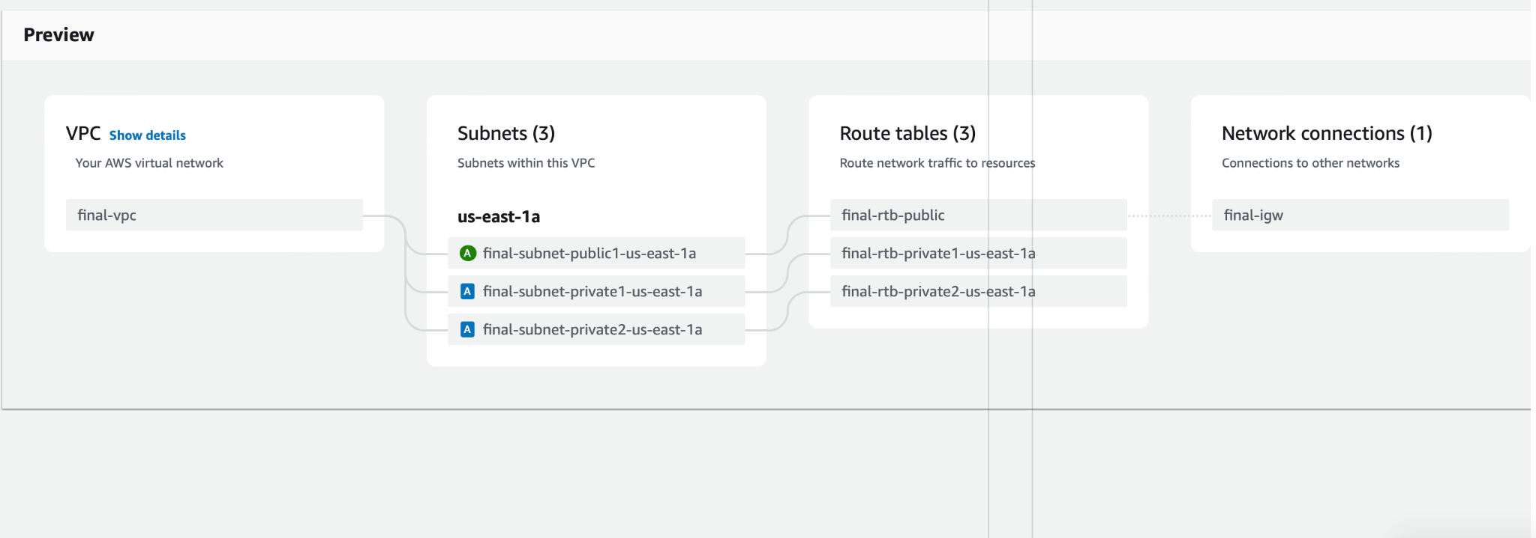
VPC LAUNCH
Notes:
Preview of VPC components during launch configuration.

Slide 7
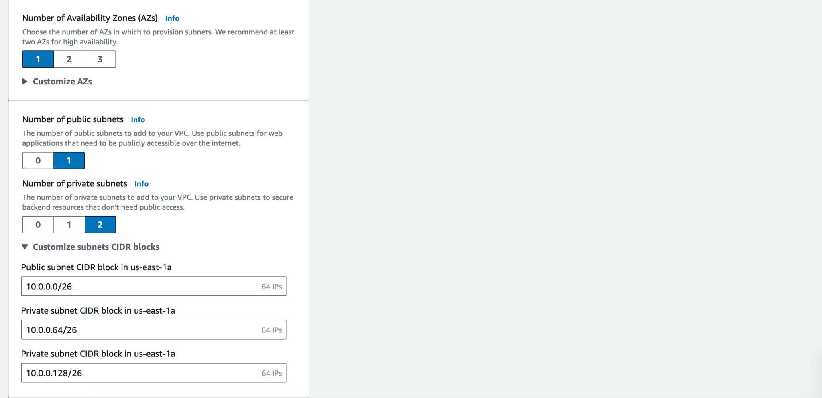
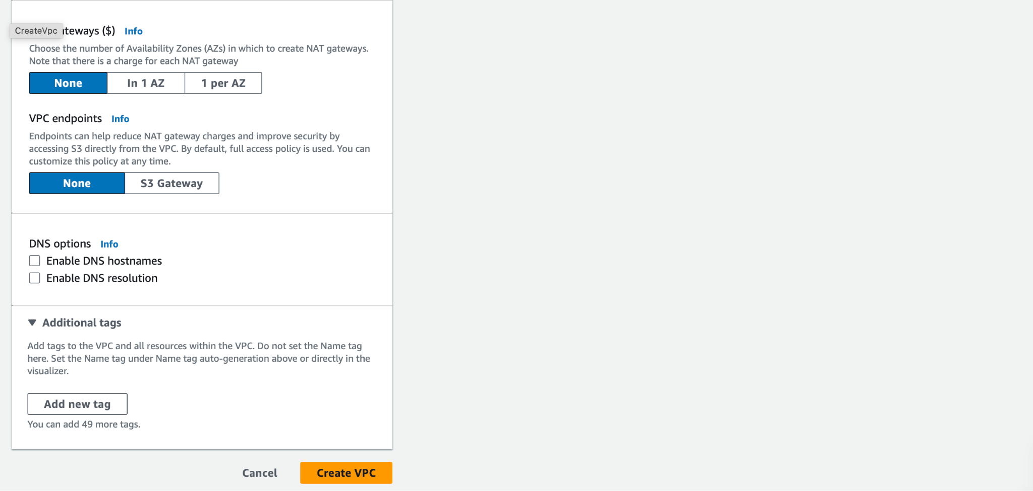
Notes:
Creating VPC; CIDR block.

Slide 8
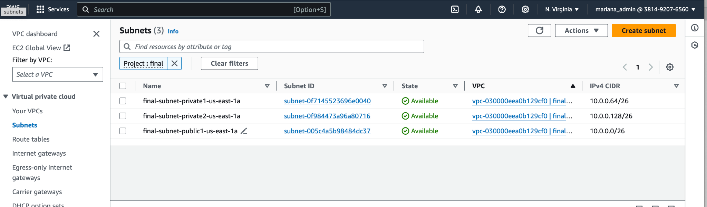
SCREENSHOT OF SUBNETS
Notes:
Public and Private subnets in project VPC. Located in North Virginia AZ (us-east-1).

Slide 9
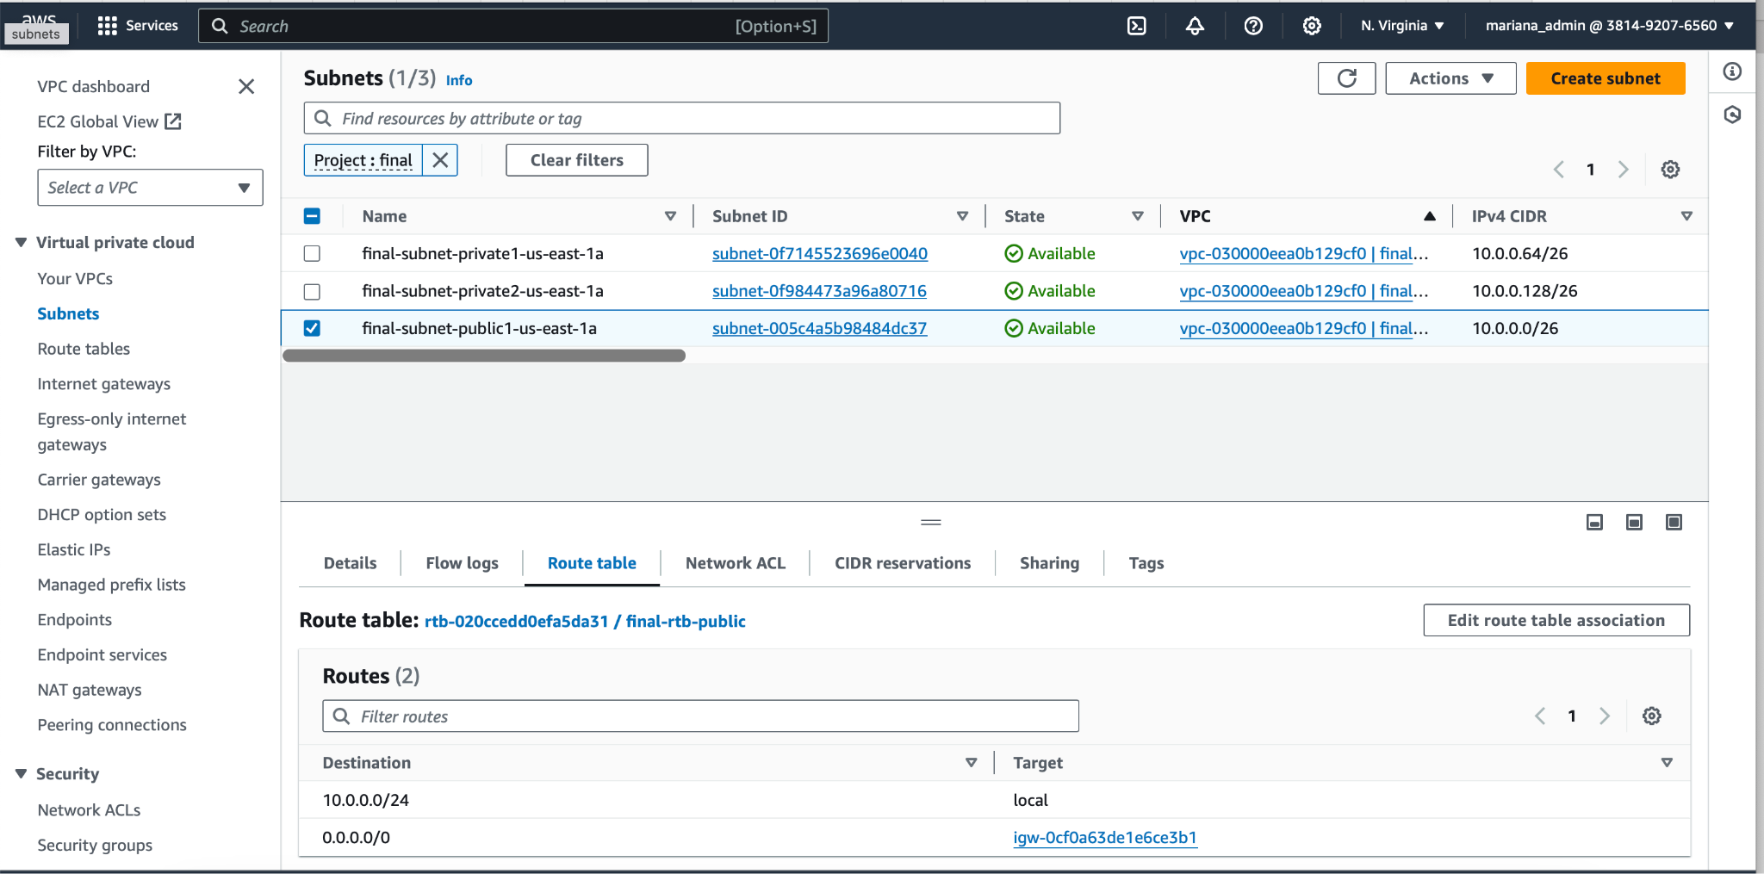
SCREENSHOT OF PUBLIC SUBNET ROUTE TABLE
Notes:
Route table has rule for traffic between subnets, one directing to internet gateway.

Slide 10
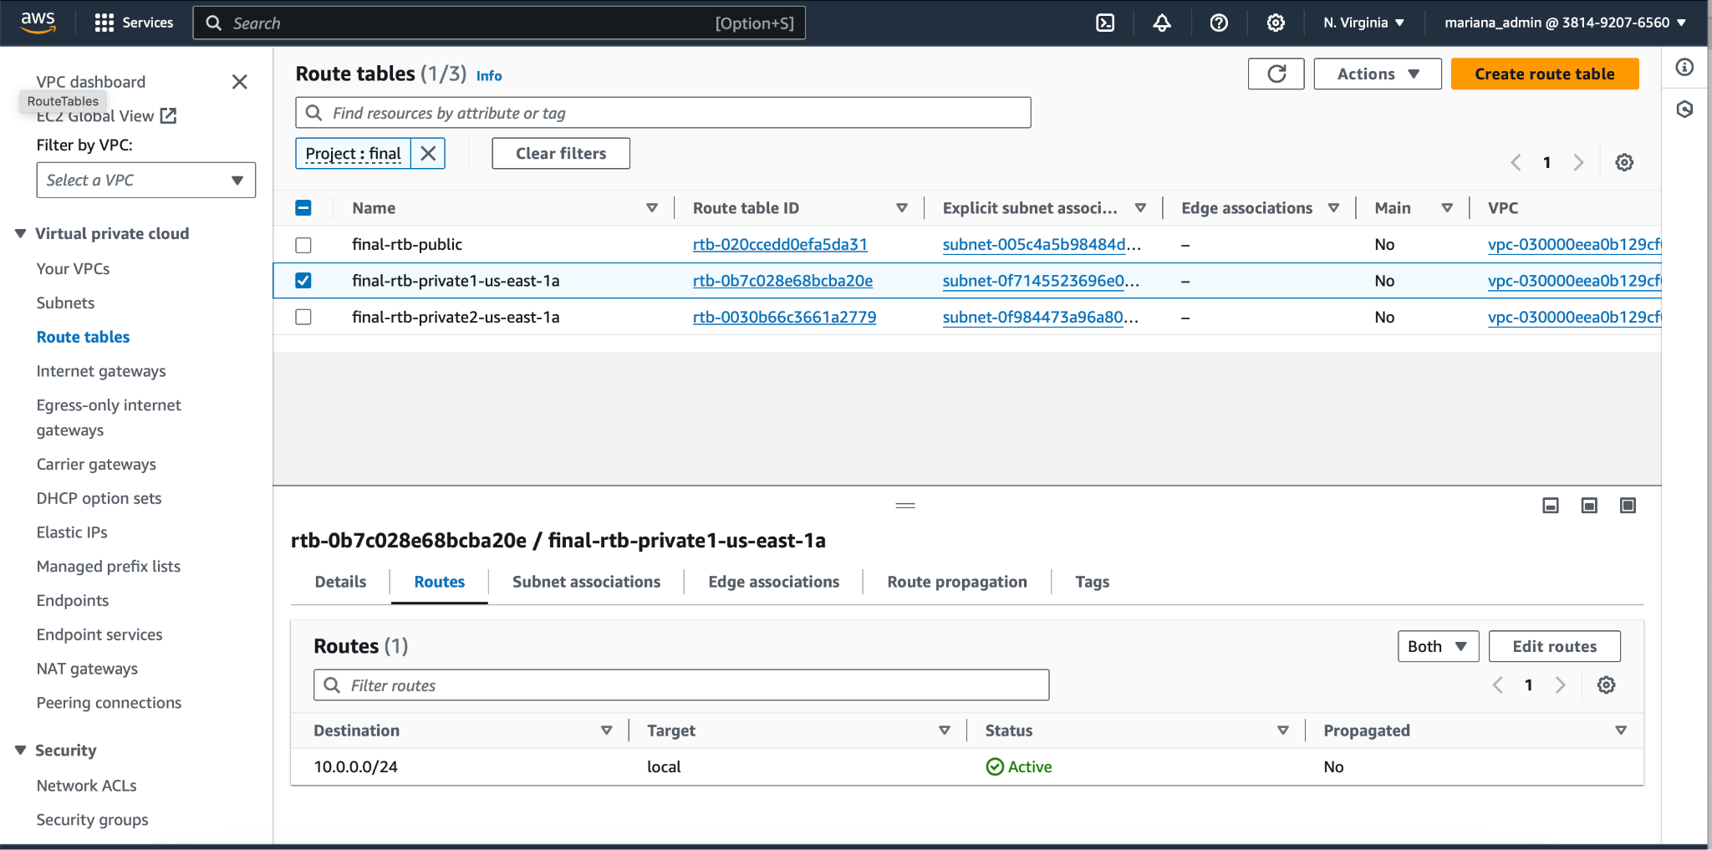
SCREENSHOT OF PRIVATE SUBNET ROUTE TABLE
Notes:
Local route for traffic between subnets.

Slide 11
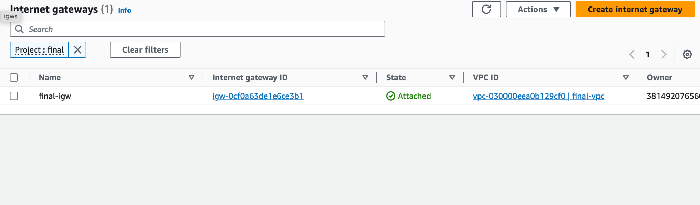
SCREENSHOT OF INTERNET GATEWAY
Notes:
Internet gateway attached to VPC for project.

Slide 12
Network ACL

Slide 13
What is the Purpose of the NACL
The Network Access Control List (NACLs) purpose is to control the traffic flow within a network. It acts as a firewall and allows you to control both inbound and outbound traffic; to and from your network sources. NACLs are applied at the subnet level and are used to filter traffic based on IP addresses, protocols, and ports. They provide an extra layer of security and help in securing your network resources from unauthorized access.
Shantericka Greene

Slide 14
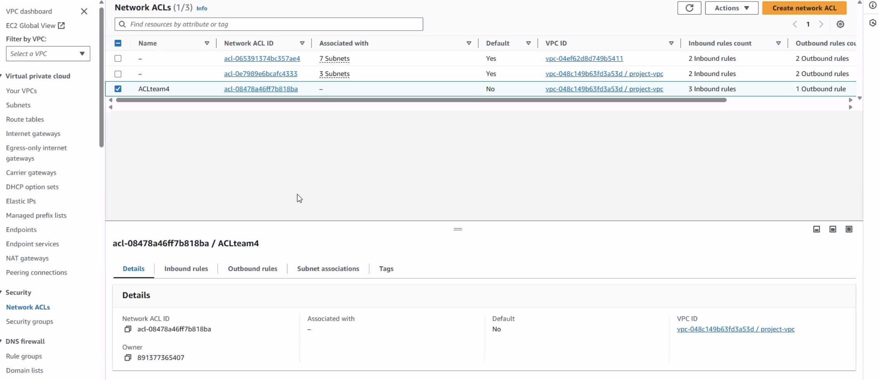
Create a Network ACl

Slide 15
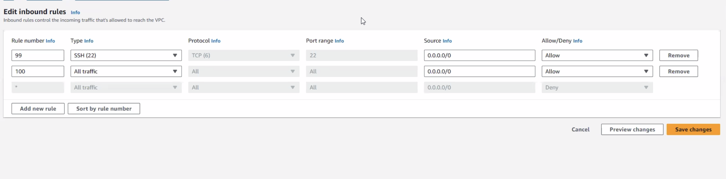
Create Inbound rules for the NACL

Slide 16
AWS EC2 INSTANCES

Slide 17
AWS EC2
AWS EC2, which stands for Amazon Elastic Compute Cloud, is a service offered by Amazon Web Services (AWS) that provides virtual servers in the cloud. Think of it as renting computing power instead of having to buy and maintain your own physical servers.
For this lab, it will be used to set up training resources/tools including our Kali attackbox and our vulnerable resource.

Slide 18
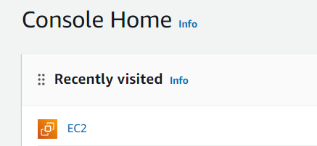
Login and click on EC2 in the AWS console
1

Slide 19
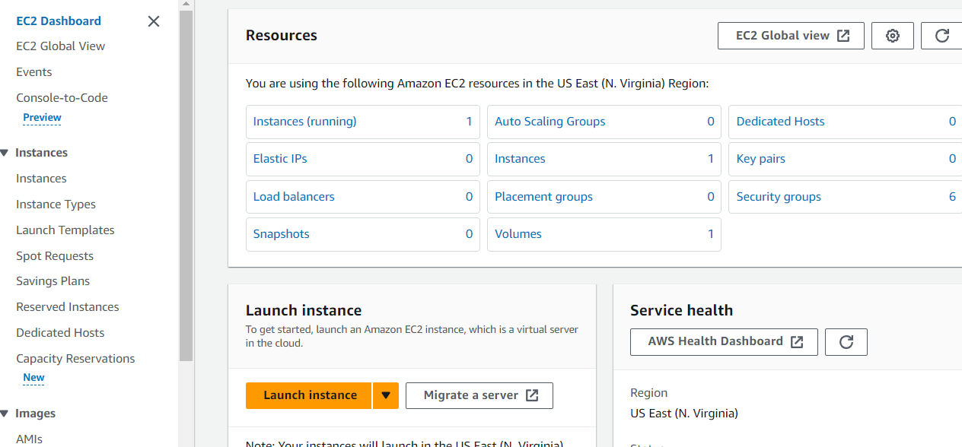
The landing page should look like this

Slide 20
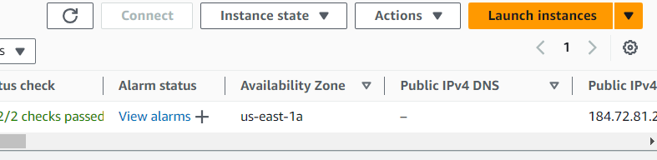
In the navigation bar on the side, click “Instances”
Then press launch instance
1

Slide 21
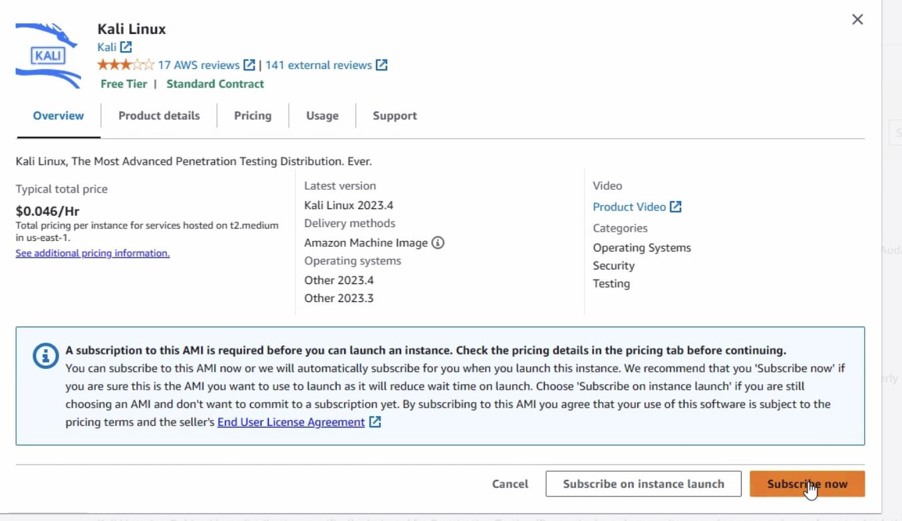
First we create our Kali instance which will serve as the attack box
**make sure to make and individual key pair for the configuration
Create Four Instances
1

Slide 22
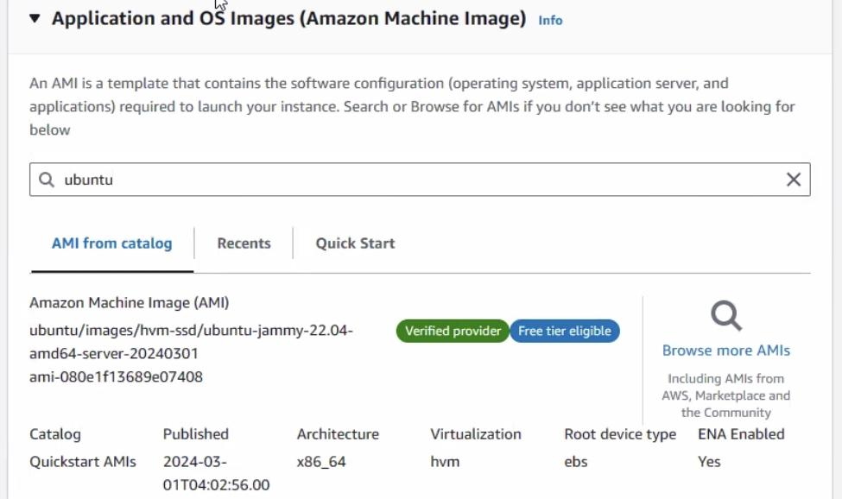
Then we create our Ubuntu which will be our vulnerable machine
**make sure to make and individual key pair for the configuration
Create Four Instances
1

Slide 23
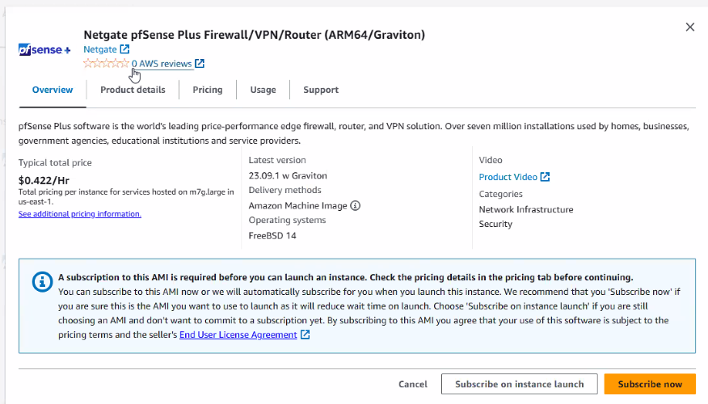
Next we create our pfSense Instance which is going to act as our firewall
**make sure to make and individual key pair for the configuration
Create Four Instances
1

Slide 24
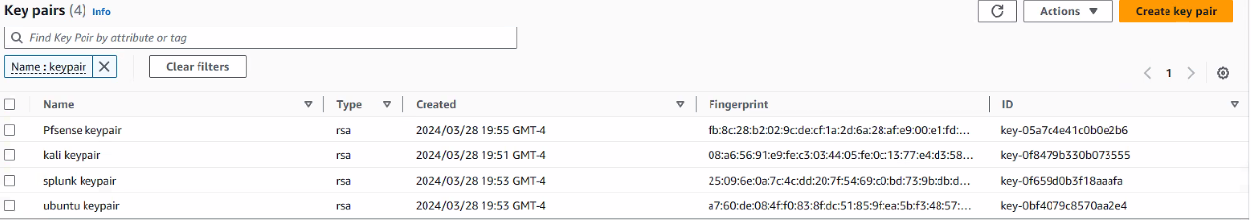
Make sure you have 3 Key Pair

Slide 25
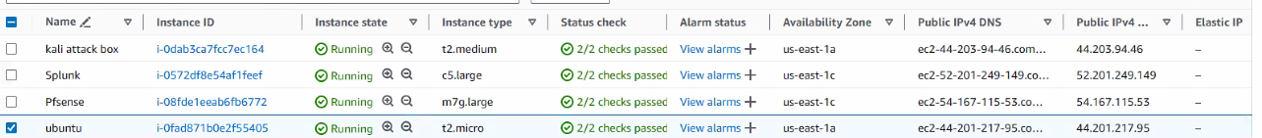
Check that all 4 instances are running
1

Slide 26
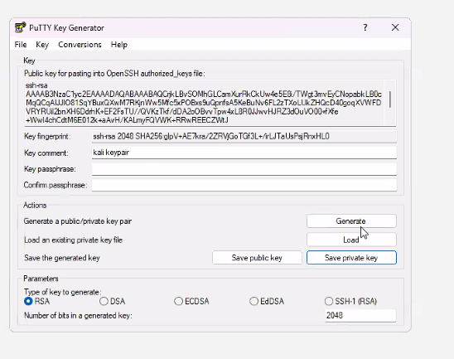
Go to the Putty Key Generator
Click Load key
Load in the Key pair we made for kali
Then save the private key (kali is part of the private subnet)

Slide 27
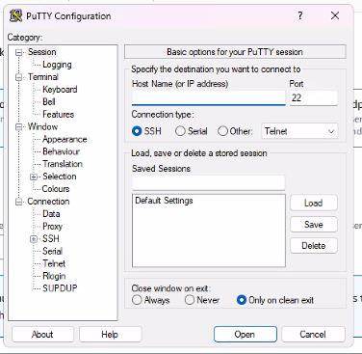
Go to PuTTY Configuration
Copy public IP address
Connection type is SSH
Loading private key pair into the putty configuration
Then open up the terminal

Slide 28
SECURITY GROUPS AS AN INSTANCE LEVEL FIREWALL
Security Groups
Security groups is a stateful firewall which can be associated with Instances.
Security groups maintain the state of connection.
For example, if a instance sends a request, the response traffic from outside is allowed back irrespective of the inbound rules, and vice versa.
Shantericka Greene

Slide 29
SECURITY GROUPS AS AN INSTANCE LEVEL FIREWALL
Security Groups Connection Tracking
Security Groups use Connection Tracking to keep track of connection information that flows in and out of an instance, this information includes — IP address, Port number and some other information(for some specific protocols).
Type — Type of Traffic which can be TCP, UDP, ICMP. Type field provides the well-used protocols, when selected it auto fills the Protocol field. You may also select a Custom Protocol Rule, which allows you to select the Protocol field from a wide range of Protocols.
Port Range — You can specify a single port or a range of ports like this 5000–6000.
Shantericka Greene

Slide 30
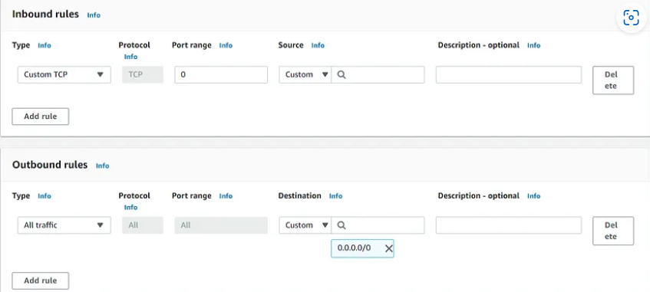
SECURITY GROUPS AS AN INSTANCE LEVEL FIREWALL
Security Group Inbound/Outbound Rules
Source[Inbound Rules only] — Can be Custom — a single IP address or an entire CIDR block, Anywhere — 0.0.0.0/0 in case of IPv4, My IP Address — AWS auto-detects your Public IP address. Destination can only be mentioned in Outbound Rule.
Destination[Outbound Rules only] — Can be Custom — a single IP address or an entire CIDR block, Anywhere — 0.0.0.0/0 in case of IPv4, My IP Address — AWS auto-detects your Public IP address. Source can only be mentioned in Inbound Rule.
Shantericka Greene

Slide 31
SECURITY GROUPS AS AN INSTANCE LEVEL FIREWALL
Security Group needs to track any connection BUT if there’s no inbound/outbound rule that means everything is allowed.
For example, Let’s say we have allowed ALL traffic from outside and ALL traffic to outside, it doesn’t need to track anything because, whatever comes and goes will be allowed.
Shantericka Greene

Slide 32
SECURITY TOOLS/GuardDuty
AWS has developed security services designed to protect your workloads and applications in the AWS Cloud. These services can help protect any type of workload operating in the cloud, not just semiconductor workloads
We plan to use GuardDuty to detect malicious activity and unauthorized behavior in your VPC. It analyzes log data from VPC flow logs and other sources to identify threats using machine learning and threat intelligence.

Slide 33
Questions?

Slide 34
References
Tips for Presenting Your Wireframes
3 Steps to Better UI Wireframes
Wireframing for Beginners

